Slide 1
Structures

Slide 2
Structures in C
Members with heterogeneous data types can be grouped together by structures in C
Syntax of a struture
struct <structure name>
{
datatype element 1 ;
datatype element 2 ;
datatype element 3 ;
......
} ;

Slide 3
Example for Structures
struct book
{
char name ;
float price ;
int pages ;
} ;
struct book b1, b2, b3 ;
Same as

Slide 4
Example for Structures
struct book
{
char name ;
float price ;
int pages ;
} b1, b2, b3 ;

Slide 5
Anonymous Structures – Structures without name
struct
{
char name ;
float price ;
int pages ;
} b1, b2, b3 ;

Slide 6
Initialization of Structures
struct book {
char name[10] ;
float price ;
int pages ;
} ;
struct book b1 = { "Basic", 130.00, 550 } ;
struct book b2 = { "Physics", 150.80, 800 } ;

Slide 7
Accessing Structure Elements
To refer pages,
b1.pages
refer to price we would use,
b1.price

Slide 8
Values of One Structure Variable to Another
struct employee
{ char name[10] ;
int age ;
float salary ;
} ;
struct employee e1 = { "Sanjay", 30, 5500.50 } ;
struct employee e2, e3 ;

Slide 9
Values of One Structure Variable to Another
/* piece-meal copying */
strcpy ( e2.name, e1.name ) ;
e2.age = e1.age ;
e2.salary = e1.salary ;

Slide 10
Values of One Structure Variable to Another
/* copying all elements at one go */
e3 = e2 ;
printf ( "\n%s %d %f", e1.name, e1.age, e1.salary ) ;
printf ( "\n%s %d %f", e2.name, e2.age, e2.salary ) ;
printf ( "\n%s %d %f", e3.name, e3.age, e3.salary ) ; }

Slide 11
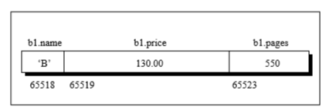
How Structure Elements are Stored
struct book
{
char name ;
float price ;
int pages ;
} ;
struct book b1 = { 'B', 130.00, 550 } ;

Slide 12
typedef in C
typedef is a keyword used in C language to assign alternative names to existing types.
Its mostly used with user defined data types, when names of data types get slightly complicated.
Following is the general syntax for using typedef:
typedef existing_name alias_name
Example
typedef unsigned long ulong;
ulong i, j ;

Slide 13
typedef in C
typedef struct {
type member1;
type member2;
type member3;
} type_name ;
Useful in structures – keyword struct need not used everywhere if it is typedef-ed.

Slide 14
Array of Structures
struct book
{
char code ;
float price ;
int pages ;
} ;
struct book b[100] ;
for ( i = 0 ; i <= 99 ; i++ )
{
printf ( "\n Enter name, price and pages " ) ;
scanf ( "%c %f %d", &b[i].code, &b[i].price, &b[i].pages ) ;
}

Slide 15
Growth of Bacteria Problem
Culturing means cultivating bacteria in a microbiology laboratory environment. Depending on the growth requirements of the bacteria and the information that the scientist hopes to gain, various types of growth media are available for culturing bacteria.
A microbiologist would use the combination-of-positives triplet as an index to a table to determine that the Most Probable Number (MPN) of bacteria per 100 ml.
Basic concept for the MPN (Most Probable Number) method is to dilute the sample to such a degree that inocula in the tubes will sometimes (but not always) contain viable organisms. By replicates, and dilution series, this will result in a fairly accurate estimate of the most probable number of cells in the sample

Slide 16
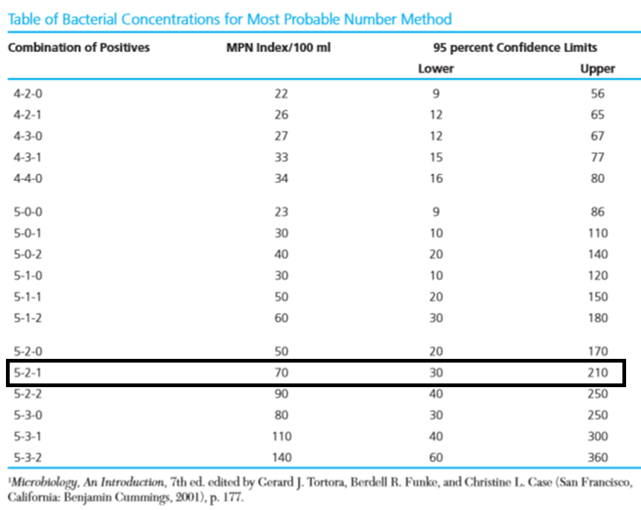

Slide 17
Growth of Bacteria Problem
5-2-1 means that all five tubes receiving 10 ml of sample show bacterial growth, only two tubes in the 1-ml group show growth, and only one of the 0.1-ml group is positive.

Slide 18
Growth of Bacteria Problem(contd ..)
Three sets of five tubes are taken. First set of five tubes of nutrient medium receives 10 ml of the sample. Second set of five tubes receives 1 ml of sample per tube, and in each of a third set of five tubes, only 0.1 ml of sample is placed. Each tube in which bacterial growth is observed is recorded as a positive. Numbers for the three groups are combined to create a triplet such as 5-2-1.

Slide 19
Growth of Bacteria Problem
For the combination of positives of 5-2-1, most probable number of bacteria per 100 ml of the sample is 70 and 95 percent of the samples yielding this triplet contain between 30 and 210 bacteria per 100 ml. Given the table and a combination-of-positives triplet, develop an algorithm and write a C program to return the index of combination-of-positives that component matches the target or -1 if not found. Print the Index value.

Slide 20
Algorithm for Bacteria Growth Problem
Read the number of entries in the table
For each entry in the table read Combination of positives, MPN Index/100ml, lower and upper limit values
Read the combination to be checked
Search the table
Print the Index

Slide 21
Implementation in C
Have to represent each row in the table
Then group the rows
Each row contains four fields
combination of positives - String
MPN Index - Int
lower limit - Int
upper limit - Int
and here heterogeneous data should be grouped

Slide 22
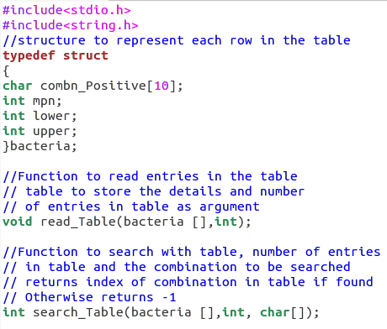
Declaration of Structure and Functions

Slide 23
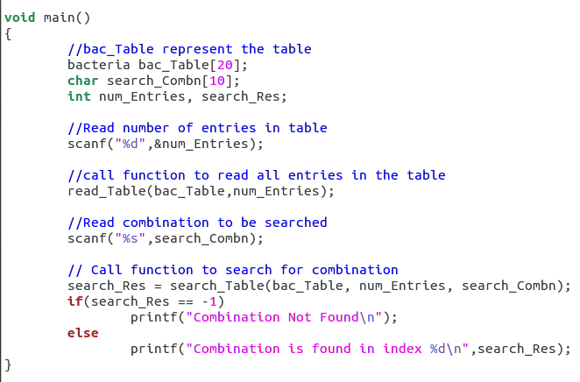
Main function of Bacteria Program

Slide 24
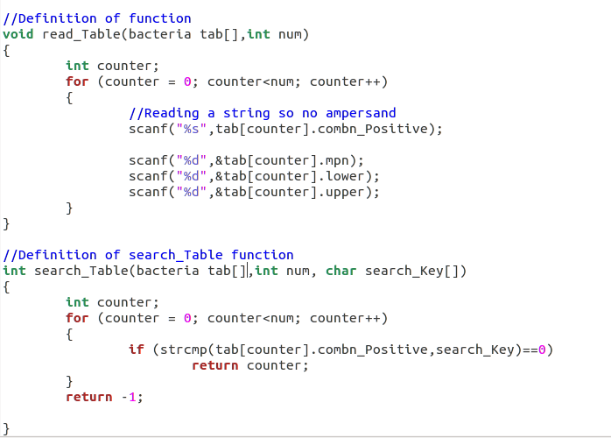
Function to Read and Search Table

Slide 25
Structure Example with Student Case Study
#include <stdio.h>
#include <string.h>
struct Student {
int roll_no;
char name[30];
char branch[40];
int batch;
};

Slide 26
struct Student s, *ptr;
int main()
{
ptr = &s;
// Taking inputs
printf("Enter the Roll Number of Student\n");
scanf("%d", &ptr->roll_no);
printf("Enter Name of Student\n");
scanf("%s", ptr->name);
printf("Enter Branch of Student\n");
scanf("%s", &ptr->branch);
printf("Enter batch of Student\n");
scanf("%d", &ptr->batch);
// Displaying details of the student
printf("\nStudent details are: \n");
printf("Roll No: %d\n", ptr->roll_no);
printf("Name: %s\n", ptr->name);
printf("Branch: %s\n", ptr->branch);
printf("Batch: %d\n", ptr->batch);
return 0;
}

Slide 27
#include <stdio.h>
#include <string.h>
struct Student {
int roll_no;
char name[30];
char branch[40];
int batch;
};

Slide 28
int main()
{
struct Student s1;
struct Student* ptr = &s1;
s1.roll_no = 27;
strcpy(s1.name, "Kamlesh Joshi");
strcpy(s1.branch, "Computer Science And Engineering");
s1.batch = 2023;
printf("Roll Number: %d\n", (*ptr).roll_no);
printf("Name: %s\n", (*ptr).name);
printf("Branch: %s\n", (*ptr).branch);
printf("Batch: %d", (*ptr).batch);
return 0;
}

Slide 29
Array within Structures
/ C program to demonstrate the
// use of an array within a structure
#include <stdio.h>
// Declaration of the structure candidate
struct candidate {
int roll_no;
char grade;
// Array within the structure
float marks[4];
};

Slide 30
// Function to displays the content of
// the structure variables
void display(struct candidate a1)
{
printf("Roll number : %d\n", a1.roll_no);
printf("Grade : %c\n", a1.grade);
printf("Marks secured:\n");
int i;
int len = sizeof(a1.marks) / sizeof(float);
// Accessing the contents of the
// array within the structure
for (i = 0; i < len; i++) {
printf("Subject %d : %.2f\n",
i + 1, a1.marks[i]);
}
}

Slide 31
// Driver Code
int main()
{
// Initialize a structure
struct candidate A
= { 1, 'A', { 98.5, 77, 89, 78.5 } };
// Function to display structure
display(A);
return 0;
}

Slide 32
Array of Structures
// C program to demonstrate the
// usage of an array of structures
#include <stdio.h>
// Declaring a structure class
struct class {
int roll_no;
char grade;
float marks;
};

Slide 33
// Function to displays the contents
// of the array of structures
void display(struct class class_record[3])
{
int i, len = 3;
// Display the contents of the array
// of structures here, each element
// of the array is a structure of class
for (i = 0; i < len; i++) {
printf("Roll number : %d\n",
class_record[i].roll_no);
printf("Grade : %c\n",
class_record[i].grade);
printf("Average marks : %.2f\n",
class_record[i].marks);
printf("\n");
}
}

Slide 34
// Driver Code
int main()
{
// Initialize of an array of structures
struct class class_record[3]
= { { 1, 'A', 89.5f },
{ 2, 'C', 67.5f },
{ 3, 'B', 70.5f } };
// Function Call to display
// the class_record
display(class_record);
return 0;
}

Slide 35
Passing to Functions
Default is passed by value
What about array in a structure?
Passed by value – Only...
But array of structures is passed by reference

Slide 36
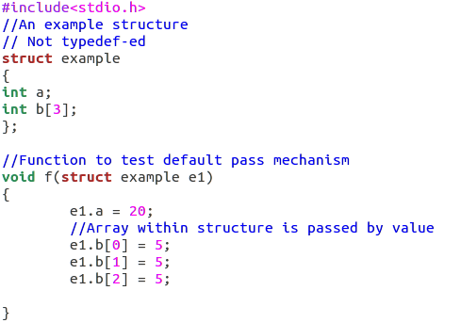

Slide 37
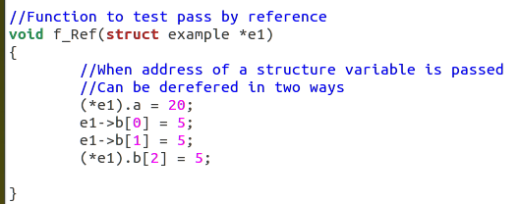

Slide 38
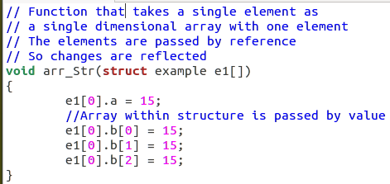

Slide 39
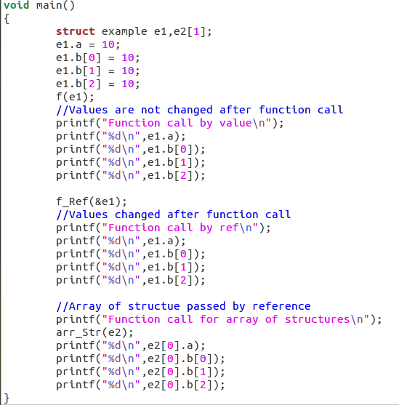

Slide 40
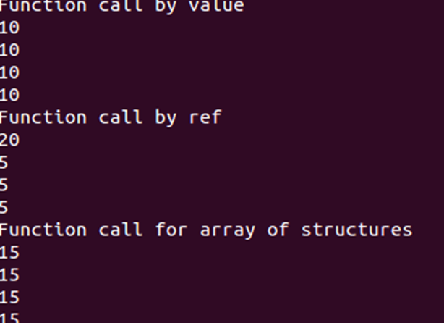

Slide 41
Surprise Gift Problem
Details of employees (emp ID, name, joining date and mobile number) of a company is stored and maintained by the company’s IT department. On his birthday, the GM of the company wants to give a surprise gift of Rs.5000 for his employees who joined before 01/01/2010 and whose employee id is divisible by 5. Develop an algorithm and write a C program to display the name of the employees who are eligible to receive the gift and their mobile number

Slide 42
Algorithm for Surprise Gift Problem
Read the number of employees
Read the details of the employees
Traverse the employee records
Check if emp id is divisible by 5
If it is divisible then check if the employee has joined the company before 01/01/2010
Display employee names and mobile numbers of employees if condition satisfied

Slide 43
Implementation in C
We have to store employee id, name, date of joining and mobile number
Date of joining has to be stored as date an user defined data type
So we have to include a structure variable as member of structure

Slide 44
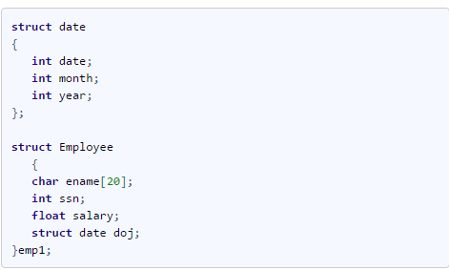
Nested Structures in C
A structure variable can be placed inside another structure

Slide 45
Nested Structures in C
A structure variable can be placed inside another structure

Slide 46
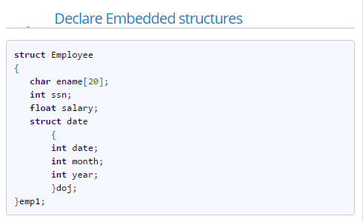

Slide 47
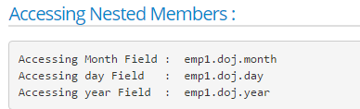

Slide 48
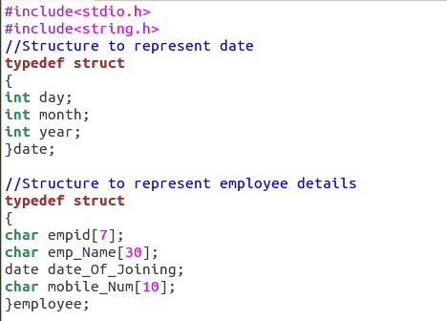

Slide 49
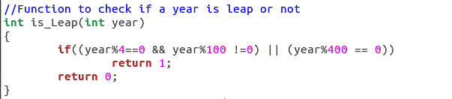

Slide 50
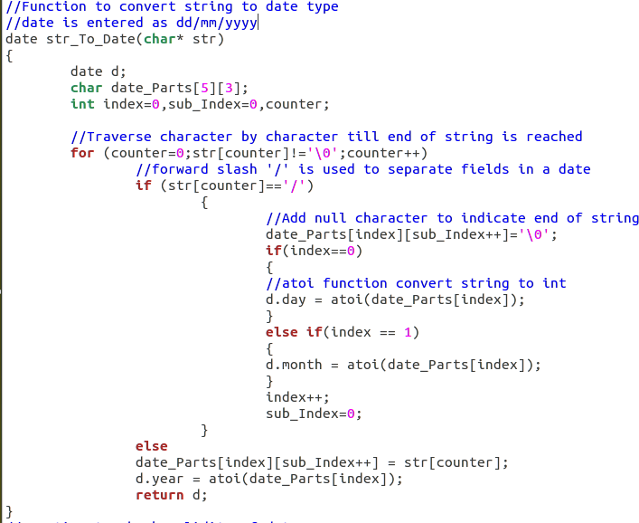

Slide 51
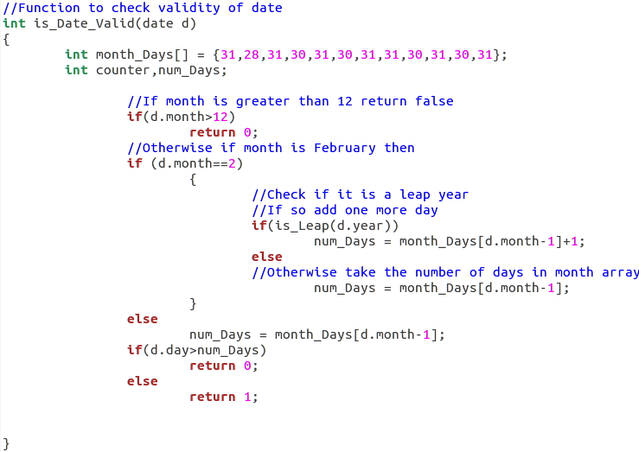

Slide 52
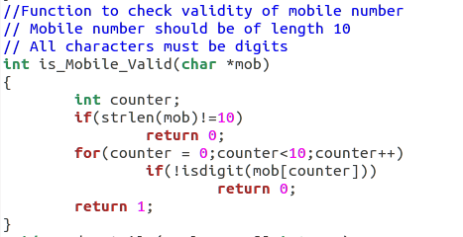

Slide 53
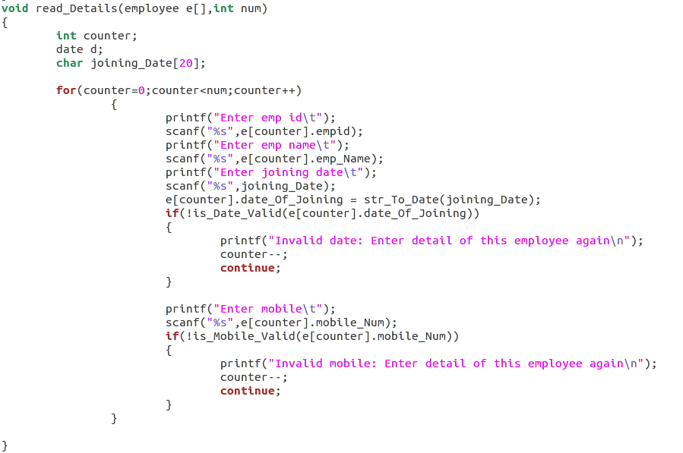

Slide 54
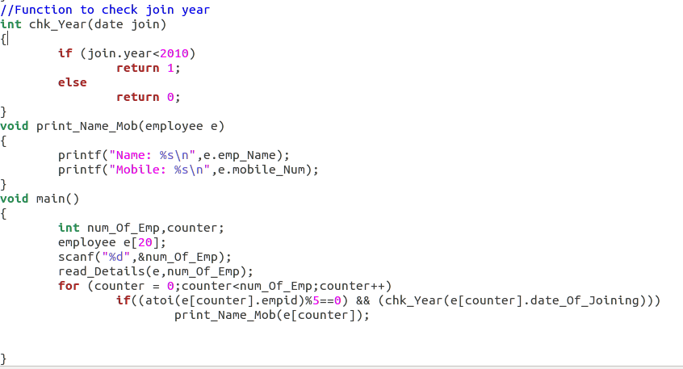

Slide 55
Identity Card for Railway Reservation
In railway reservation system, identity of the person is got by either aardhar card number or voter id. Given Aardhar card number as a number and voter id as a string. Write a C program to store the details of thousands of people. It is important to store such that less memory is wasted.

Slide 56
Using Structures?
Structure can be used to store the details but the memory occupied will be sum of memory required for both the fields.
A large wastage when the program is used to store details of many people
Since either one of the detail is going to be stored, it is sufficient to allocate memory for the largest member
Supported in C as Unions!

